Slide 1



GAMING MARKET RESEARCH AND ANALYTICS
Made by: Sankalp Singh Thakur
Notes:
Always have an interesting title for your presentation. Something that captures the sense of the presentation, and gives the audience a little bit of a peek into something that is unique about the solution and recommendation that you are providing. Just something to draw the audience in and pique their interest.

Slide 2
EXECUTIVE SUMMARY
GENRE SELECTION
AGENDA
OVERVIEW OF GAME 1
OVERVIEW OF GAME 2
RECOMMENDATIONS
Notes:
In the agenda slide, not only are you letting your audience know what to expect from this presentation, but in the event that they would come back to this presentation and look for certain parts that they wanted to check out, this should serve as a guide for them to do that.

Slide 3
Executive Summary
Valorant has a robust esports ecosystem, making it a prime subject for studying competitive gaming dynamics and community engagement.
Spider-Man offers a rich narrative and character development, ideal for studying storytelling in games and player emotional engagement.
Market Relevance: Both games are highly popular and influential, providing relevant data for current market trends and future developments.
Player Engagement: Understanding the factors that drive player retention, satisfaction, and community involvement.
Innovation in Design: Gaining insights into successful game design principles, from competitive balance to immersive storytelling.
Notes:
This should, in theory, be one slide that if a busy executive had no time, other than to see just one slide, they should be able to see the executive summary and come away with all of the information that they needed to know about this presentation. The executive summary follows the pyramid principle, which is a school of thought, that says instead of taking your audience on a long-winded journey of how you got to a certain recommendation or conclusion, you give them the recommendation or conclusion and key takeaways from your analysis, right in the beginning. Then take your audience through the journey of how you got there and what methodology you used, what insights you gained along the way, the rationale, et cetera. And then, you recap your conclusion again at the end of the presentation. So in this way, your analysis and your recommendations are book-ended first by the conclusion right in the beginning, and again, in the end. This sort of bookending creates a really impactful convincing presentation.

Slide 4



Miles Morales Genre : Action-Adventure
Valorant Genre: First-Person Shooter
Why I chose VALORANT:
The game has approximately 5 million players actively engaging daily. This significant player count highlights Valorant's popularity and staying power in the competitive gaming market​
Why I chose SPIDERMAN:The game sold 4.1 million units by the end of 2020. It remains popular, continuing to attract players due to its engaging storyline, innovative mechanics, and availability across PS4 and PS5 platforms
PLAYER PSYCHOLOGY
Competitive Players
Streamers and Content Creators
Social Players
Casual players
PLAYER PSYCHOLOGY
Story-Driven Gamers
Streamers
Casual players
Marvel fans
Superhero game fans
Notes:
Slide Design:
Choose a clean and minimalist design with a consistent layout for each game.
Use a color scheme that complements the overall theme or style of the games.
Consider using a grid-based layout or visually appealing shapes to organize information.
Limit Text and Use Visuals:
Keep the text concise and avoid overcrowding the slide with excessive information.
Use visuals, icons, or symbols to represent key concepts whenever possible, reducing the reliance on lengthy explanations.
Focus on capturing the essence of each aspect without overwhelming the viewer.

Slide 5
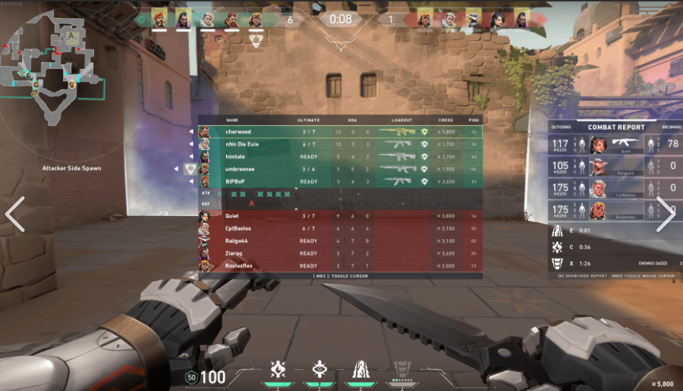
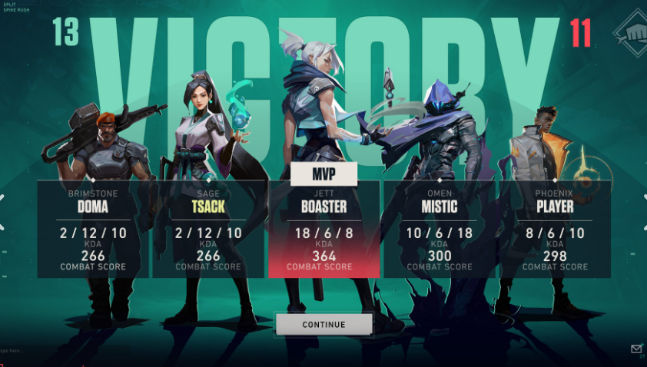

GAME GENRE/OVERVIEW OF VALORANT
OVERVIEW OF FPS GAMES
Tactical gameplay
Unique agents
Competitive modes
High quality graphics
Esports Ecosystem
most popular FPS game
Daily 5 million active players.
Streamers and Esports athletes.
GAMEPLAY MECHANICS
Precise Gunplay
Agent Abilities
Map control
Team Coordination
Spike Management
Health and Armour
Economy System

Slide 6
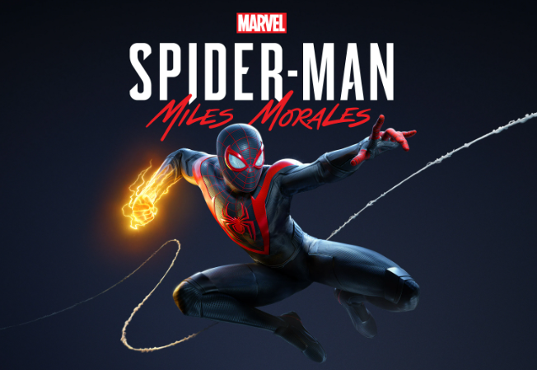
GAME GENRE/OVERVIEW OF MARVEL’S SPIDER-MAN :MILES MORALES
OVERVIEW OF ACTION ADVENTURE GAMES
Dynamic Combat System
Unique Abilities
Engaging Storyline
Open world exploration
Character development
Stunning visuals and high graphics
GAMEPLAY MECHANICS
Web-slinging
Combat system
Camouflage
Traversal
Side missions and activities
Skill tree
Gadgets

Slide 7
Recommendations for Mobalytics
VALORANT
Market Research and Player Insights: Conduct comprehensive market research to identify target demographics and understand player preferences, behaviors, and motivations. Provide insights into potential new player segments that Valorant could appeal to, and tailor marketing strategies accordingly.
Player Retention Strategies: Analyze player retention metrics and behavior patterns to identify factors influencing player churn. Propose features, content updates, and progression systems that can increase player engagement and longevity in the game.
Accessibility: By enabling players on mobile devices to join matches with PC players, Valorant becomes more accessible to a wider audience who may prefer different gaming platforms.
SPIDERMAN : MILES MORALES
Expanding Accessibility: Introduce scaled-down versions of these games for PC and mobile platforms, broadening accessibility beyond the current PlayStation Network exclusivity. This expansion aims to reach a wider audience of gamers eager to experience these titles on their preferred devices.
Enhancing Engagement through Competition: Implement competitive leaderboards to bolster player retention and long-term engagement. By integrating these features, players can strive for recognition and achievements, fostering sustained interest in the games over time.
Enabling Multiplayer options: Multiplayer option will increase the in game retention and engagement as people like playing a story mode game with their friends.

Slide 8
Thank you!
Made By: Sankalp Singh Thakur
Gmail: 7sankalpthakur@gmail.com
linkedin: www.linkedin.com/in/sankalpsinghthakur
Notes:
Make sure you have your pictures, your school’s email, LinkedIn. So people know who you are and who’s responsible for this presentation. And if someone were to get in touch with you regarding the presentation, they should be able to do that.

